Slide 2
Argo CD Core
A Pure GitOps Agent for Kubernetes
Alexander Matyushentsev, Akuity
Leonardo Luz Almeida, Intuit

Slide 3


Intro
Alexander Matyushentsev Argo Project co-creator
Co-founder and Chief Architect at Akuity
Leonardo Luz Almeida
Argo CD and Argo Rollouts maintainer Staff Software Developer at Intuit

Slide 4
Agenda
Problem Statement
Argo CD Component Architecture
Argo CD Core Introduction
Cluster Admins & Dev Teams use cases
Demo
Notes:
I’ll start with the problem statement providing a list of use cases that Argo CD Core aims to address
But before jumping into what Argo CD Core is, I’d like to provide a brief overview of Argo CD component Architecture.
The goal is that with this piece of knowledge, things will look less magical and more logical.
Alex will join the presentation providing a suggestion on how to address the use cases using Argo CD Core.
Keep in mind that all examples used during his demo are available in a dedicated github repo. We are going to share the QR code to that repo in a future slide so you have easy access to it. So, leave your cel phone prepared.

Slide 5
Problem Statement
“Argo CD is great but the feature X doesn’t fit our use-case”
Examples:
Multi-tenancy
Proprietary RBAC model
Proprietary API
OIDC based authentication
UI & CLI
Notes:
We hear constructive criticism and we selected a list of them to base our talk
It usually goes by..
Everybody likes UI and CLI but maybe they are not willing to configure SSO for enabling those tools
It was a bit disappointing for us because Argo CD Core addresses all that and it is available since v2.1 (released July 2021)
We recognize a major issue which is the fact that it had minimal documentation
Last Friday we merged a new dedicated page in the official Argo CD documentation

Slide 6
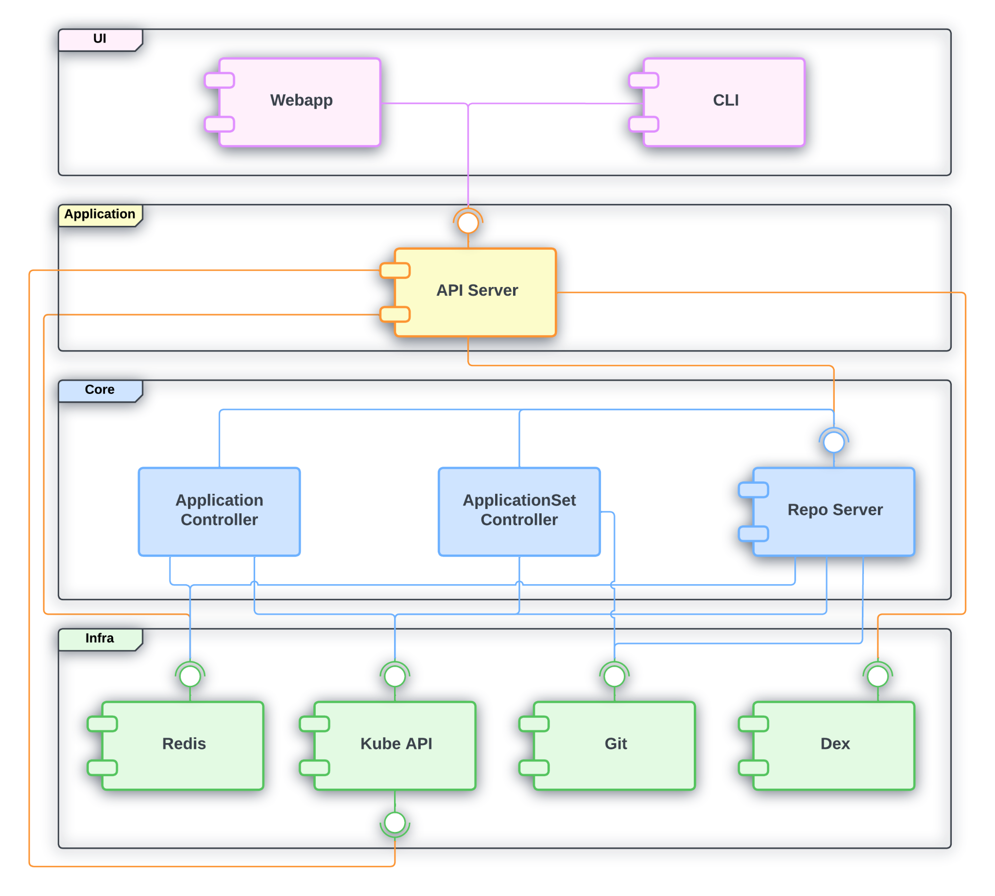
Argo CD Component Architecture

Slide 7
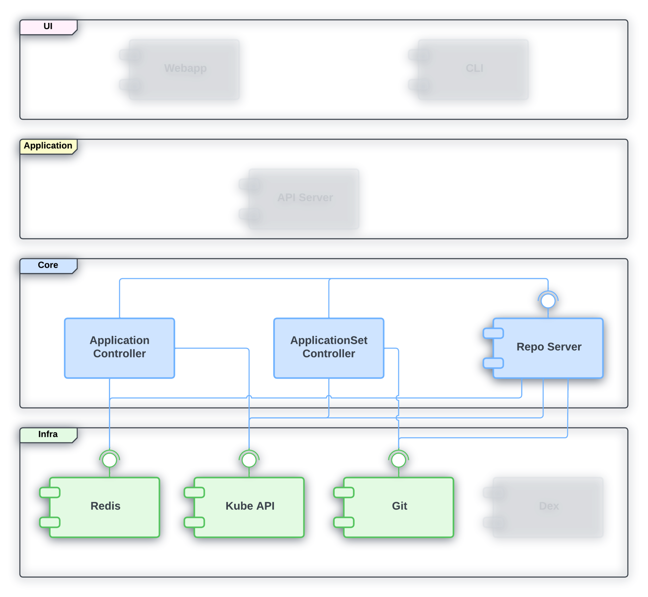
Argo CD Core Introduction

Slide 8
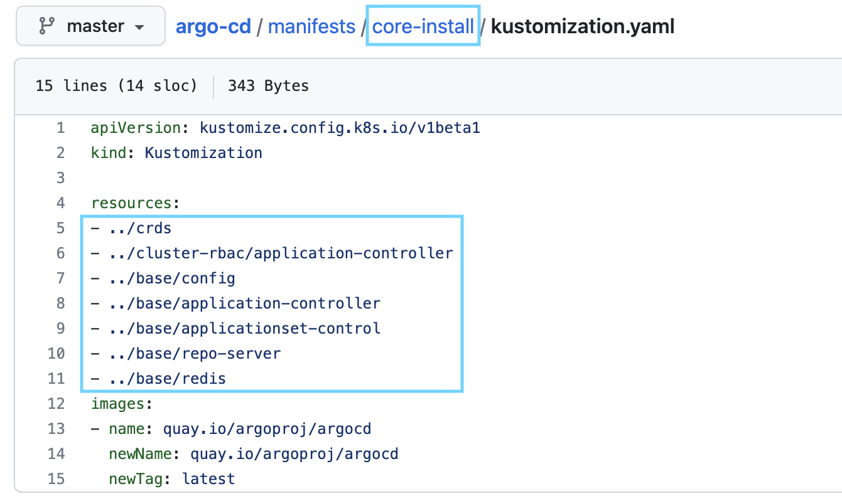
Argo CD Core Introduction

Slide 9
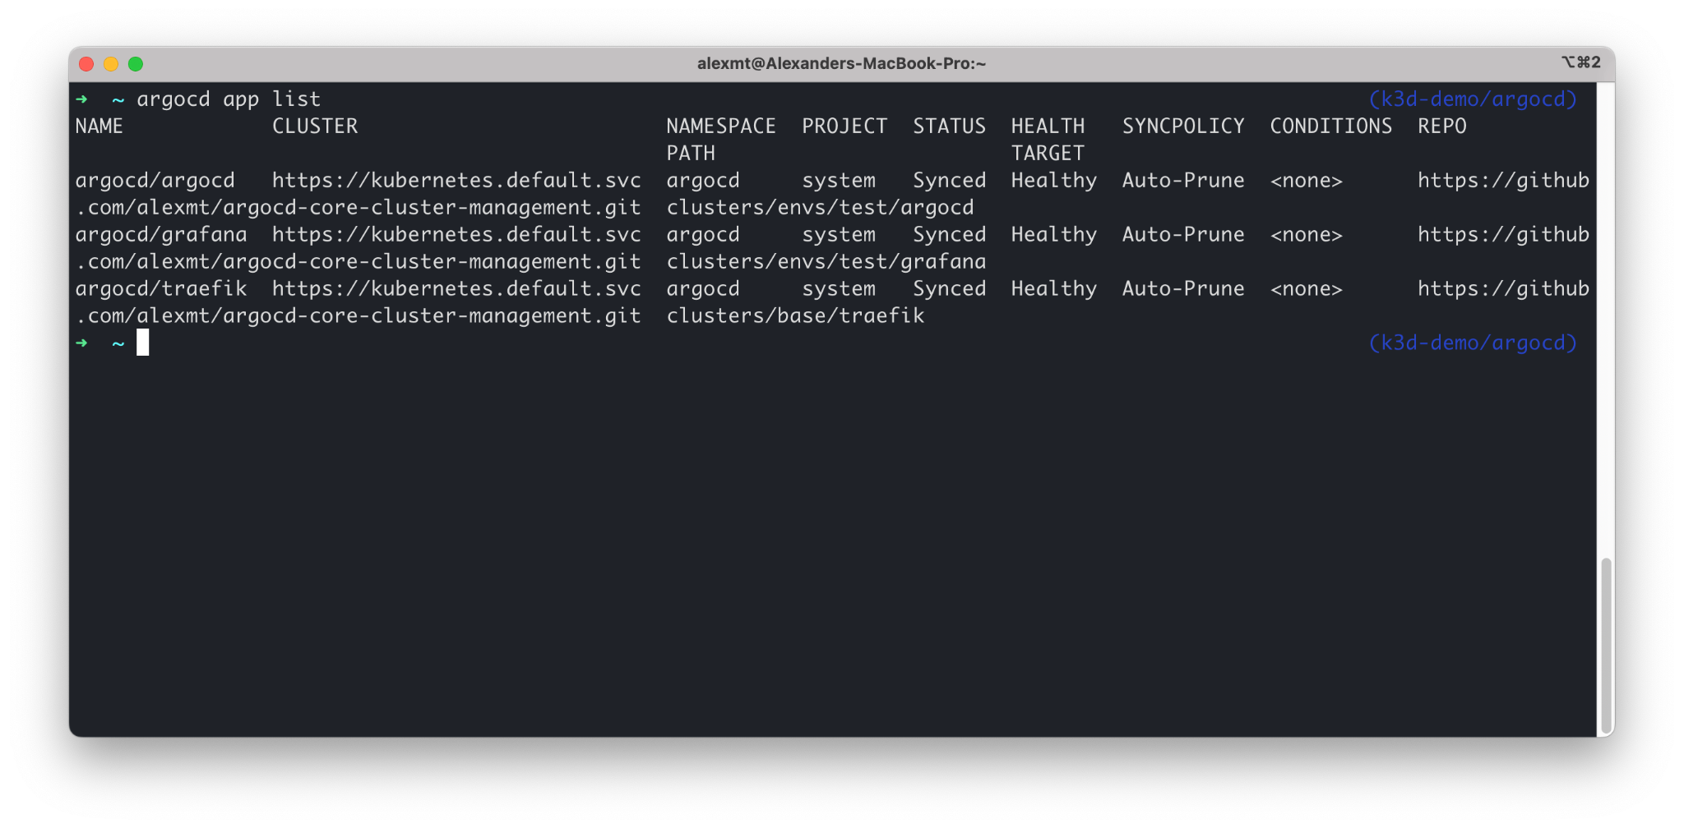
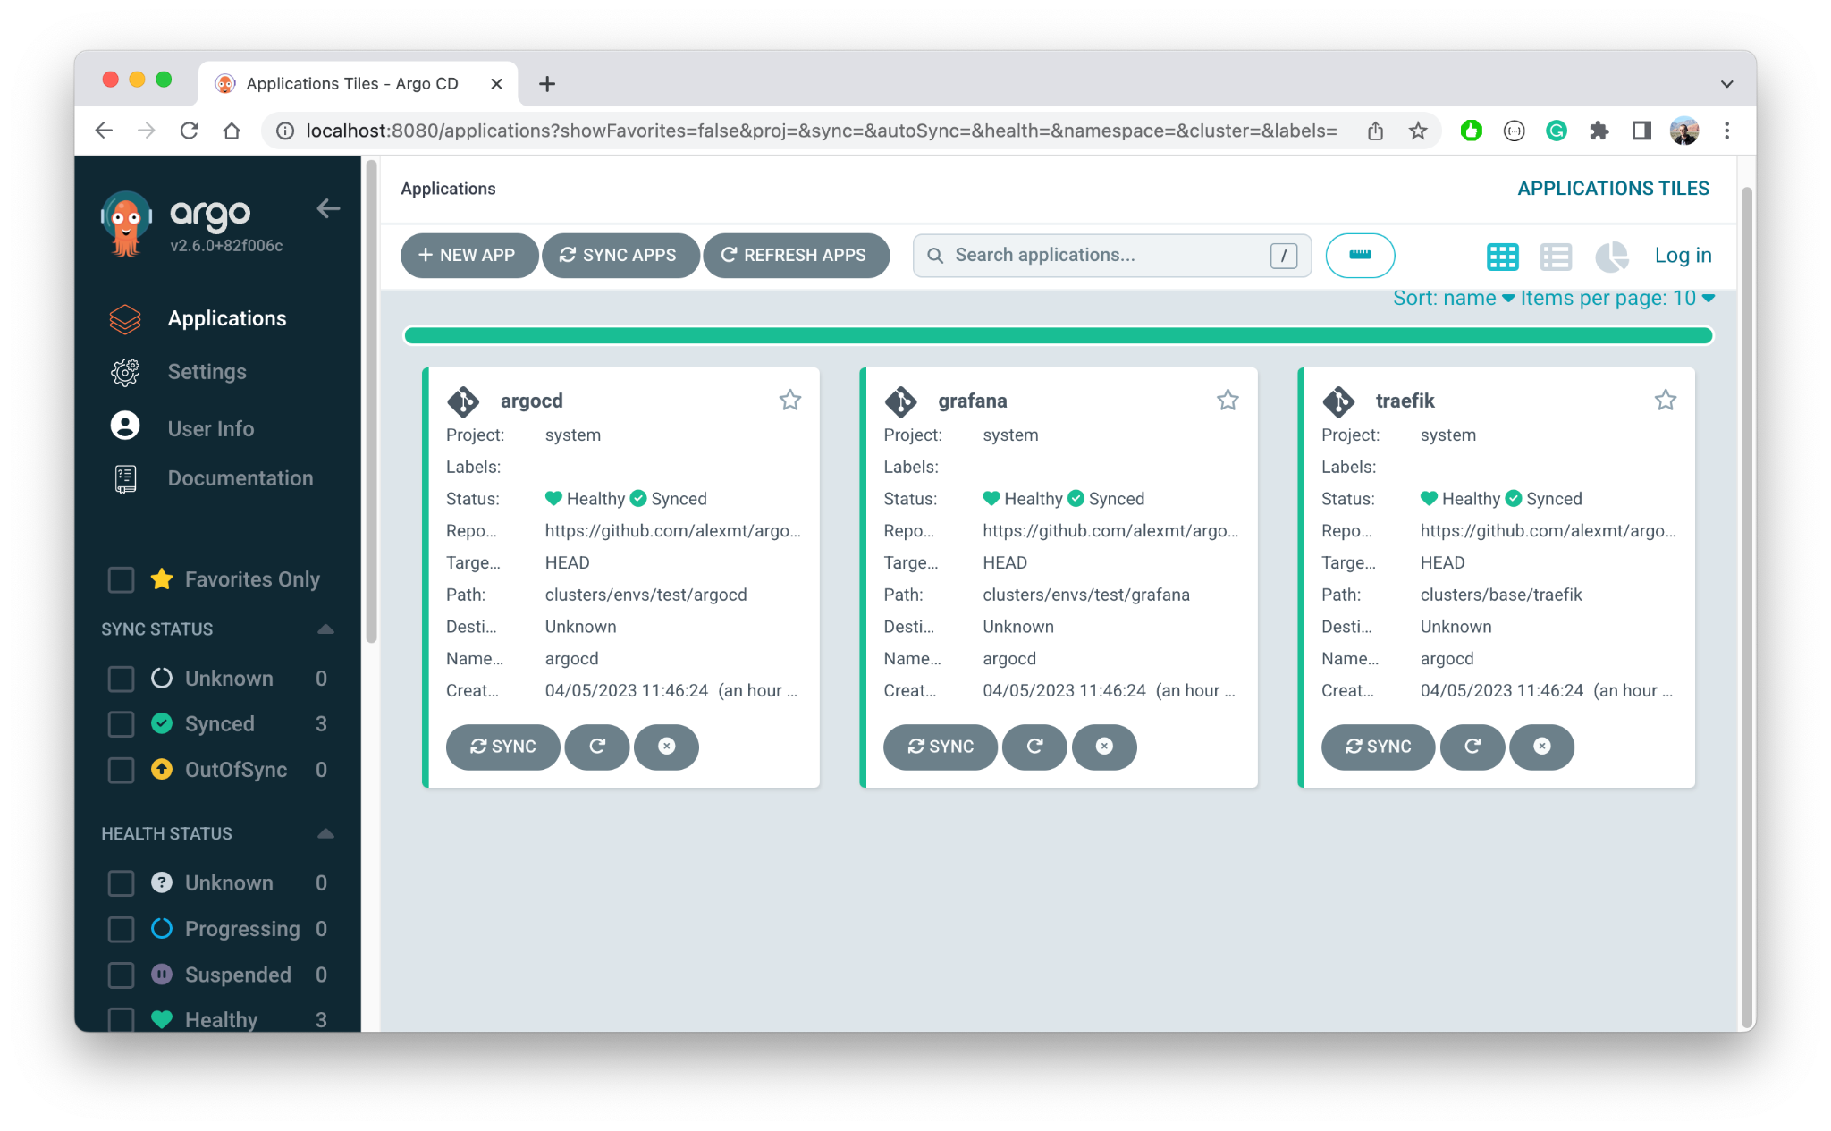
Demo - User Experience
Argo CD Core installation
Using Argo CD CLI with Core
Use Web UI with Core
Notes:
Thanks Leo for great overview of the problem and description of how Argo CD Core solves it. The next part of a presentation is going to be more hands on and we will have a demo!
The main challenge with any Argo CD demo is that it is typically fully GitOpsed so only manual step is one kubectl apply command and kind of nothing else to demo. So I have two more slides to explain what exactly I’m going to demo.
Long story short: I will be showing Argo CD core in action and explains how it can be used to efficiently solve cluster administrator use cases.
As you could understand from presentation so far Argo CD Core is pretty much a headless distribution of Argo CD. However it is only different set of YAMLs that install less number of components. There also features that enables full Argo CD experience with headless installation. During the demo I will explain how to use Argo CD CLI and even UI without running Argo CD API Server, configuring system accounts or integrating it with SSO.

Slide 10
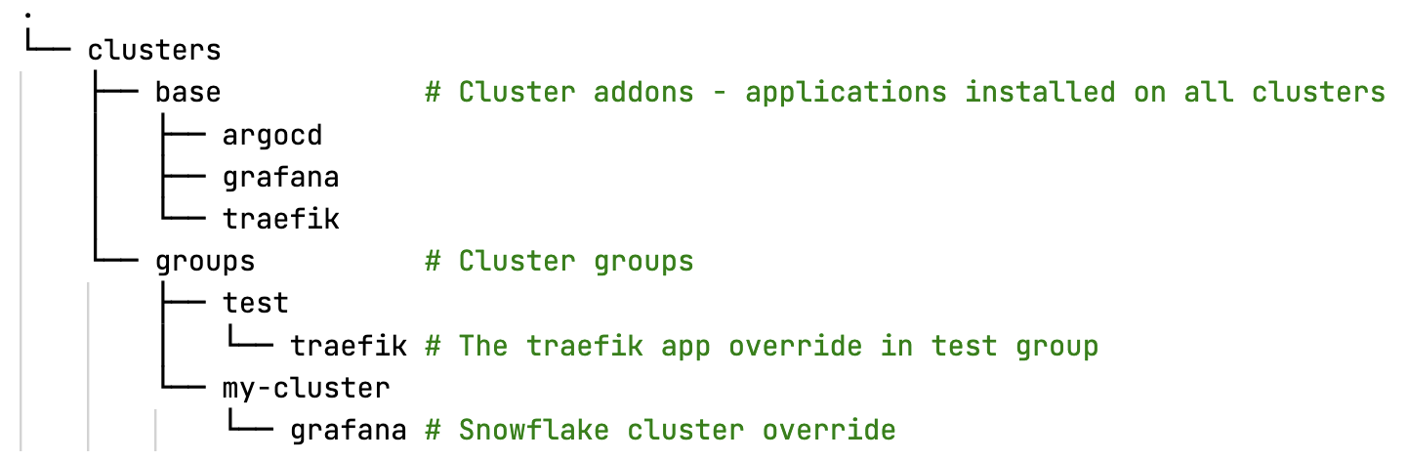
Demo - Cluster Administrator Use Cases
Cluster Addons - homogeneous set of applications in each cluster
Cluster Groups - ability to split the clusters fleet into multiple groups and customize each group
Snowflake Clusters - ability to customize the applications configuration on a per-cluster basis
Notes:
Once we understand how to install and use Argo CD Core I want to focus on how to use it practically. In particularly I want to talk about configuration management problem. The main and obvious difference between centrally managed Argo CD and Argo CD Core is that second supposed to install inside of the managed clusters as opposed to single control plane cluster. That means Argo CD configuration is also distributed across multiple clusters. Cluster administrator use cases make the problem even worse: administrators need to install way more components using Argo CD. So in summary they need to manage a lot more Argo CD settings distributed across multiple k8s clusters.
To help address this problem we’ve identified main use cases that cluster administrators have to solve and proposed fully automated solution using Argo CD component - application set. So using this approach administrator need to bootstrap cluster once and further cluster management is happening in git only and administrator never have to run kubectl commands against it.
The use cases and proposed Git repository structure you can see on the screen.
The first use is Cluster addons - a set of applications installed in each cluster. Typically it is a set of critical components are provided as a service to end users, developers, and includes applications like grafana, ingress controller, prometheus, externals dns and so one.
This base set of applications is represented by directory base in our git repository. The base has a bunch of sub-directories - one per application. ApplciationSet should watch list of these directories and create/delete new argocd application every time when admin make a change in git.
The next use case is cluster groups. In real life we indeed need to install the same set of components on each cluster but never with the exact same configuration. So we want to let enable administrators to provide logical cluster grouping and then introduce customizations into each group independently.
This use case is represented in groups folder. The groups folder has sub-folders, one for each group. And each group folder has application specific folder with group application customization. So if administrator decided to change version of let’s say traefik installation in test clusters then he/she needs to create traefik directory under test folder in groups. ApplicationSet should notice it and change treafik ArgoCD app path to test group folder path.

Slide 11

Demo - Let’s Get Started!
https://github.com/alexmt/argocd-core-cluster-management
Notes:
I hope all of it makes sense. If not don’t worry, I will show it in action right now and if it still not clear you have the demo repository and repeats the idea.

Slide 12

Session QR Codes will be
sent via email before the event
Please scan the QR Code above
to leave feedback on this session

